Slide 1
Unit III
Programming Through Java Code: 502

Slide 2
Contents
String handling
Exploring java.lang
Utility classes
Exploring java.io

Slide 3
String handling

Slide 4
String
String represents fixed-length, immutable character sequences.
Java implements strings as objects of type String class.
“Al pacino" (a name)
“102 Main Street" (a street address)
“Chandmari, Tura" (a city and state)
"(201) 555-1212" (a telephone number)
String Reference
String color = "blue";

Slide 5
Class String
Class String is used to represent strings in Java.
Class String provides constructors for initializing String objects in a variety of ways.
The java.lang.String class provides many useful methods to perform operations on sequence of char values.

Slide 6
Example
public class StringConstructors
{
public static void main( String[] args )
{
char[ ] charArray = { 'b', 'i', 'r', 't', 'h', ' ', 'd', 'a', 'y' };
String s = new String( "hello" );
// use String constructors
String s1 = new String();
String s2 = new String( s );
String s3 = new String( charArray );
String s4 = new String( charArray, 6, 3 );
System.out.printf("s1 = %s\ns2 = %s\ns3 = %s\ns4 = %s\n",s1, s2, s3, s4 );
}
}

Slide 7
String
In java, string objects are immutable. Immutable simply means un-modifiable or unchangeable.
Once string object is created its data or state can't be changed but a new string object is created.

Slide 8
Why string objects are immutable in java?
Because java uses the concept of string literal. Suppose there are 5 reference variables, all refers to one object “Java". If one reference variable changes the value of the object, it will be affected to all the reference variables. That is why string objects are immutable in java.

Slide 9
Character Extraction
The String class provides a number of ways in which characters can be extracted from a
String object.
charAt: obtain the character at a specific location in a String
char charAt(int index)
e.g.,
char ch;
ch = "abc".charAt(1);
assigns the value “b” to ch.

Slide 10
Character Extraction
getChars: retrieve a set of characters from a String as a char array.
void getChars(int sourceStart, int sourceEnd, char target[ ], int targetStart)
Here, sourceStart specifies the index of the beginning of the substring, and sourceEnd
specifies an index that is one past the end of the desired substring.

Slide 11
Example
class getCharsDemo {
public static void main(String args[]) {
String s = "This is a demo of the getChars method.";
int start = 10;
int end = 14;
char buf[ ] = new char[end - start];
s.getChars(start, end, buf, 0);
System.out.println(buf);
}
}
Output:
Here is the output of this program:
demo

Slide 12
Character Extraction
getBytes() method returns the byte array of the string.
public byte[] getBytes()
e.g.,
String s1="ABCDEFG";
byte[ ] barr= s1.getBytes();
for(int i=0;i<barr.length;i++)
System.out.println(barr[i]);
Output: 65 66 67 68 69 70 71

Slide 13
Character Extraction
toCharArray( ): to convert all the characters in a String object into a character array, the easiest way is to call toCharArray( ).
It returns an array of characters for the entire string.
char[ ] toCharArray( )

Slide 14
example
String s1="hello";
char[] ch=s1.toCharArray();
for(int i=0;i<ch.length;i++)
{
System.out.print(ch[i]);
}

Slide 15
String Comparison
The String class includes several methods that compare strings or substrings within strings.
equals( ) and equalsIgnoreCase( ):
equals( ):To compare two strings for equality.
boolean equals(Object str)
e.g.,
String s1 = "Hello";
String s2 = "Hello";

Slide 16
String Comparison
equalsIgnoreCase( ).:To perform a comparison that ignores case differences.
String s1 = "Hello";
String s2 = "HELLO";
s1.equalsIgnoreCase(s2)

Slide 17
startsWith( ) and endsWith( )
The startsWith( ) method determines whether a given String begins with a specified string.
Conversely, endsWith( ) determines whether the String in question ends with a specified
string.
boolean startsWith(String str)
boolean endsWith(String str)
e.g., "Football".endsWith("ball")

Slide 18
equals( ) Versus ==
It is important to understand that the equals( ) method and the == operator perform two
different operations.
the equals( ) method compares the characters inside a String object.
The == operator compares two object references to see whether they refer to the same instance.

Slide 19
Example
String s1 = "Hello";
String s2 = new String(s1);
System.out.println(s1 + " equals " + s2 + " -> " +
s1.equals(s2));
System.out.println(s1 + " == " + s2 + " -> " + (s1 == s2));
The variable s1 refers to the String instance created by "Hello". The object referred to by s2 is created with s1 as an initializer. Thus, the contents of the two String objects are identical, but they are distinct objects. This means that s1 and s2 do not refer to the same objects and are, therefore, not ==
Output: Hello equals Hello -> true Hello == Hello -> false

Slide 20
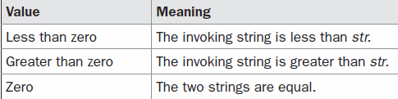
compareTo( )
int compareTo(String str)

Slide 21
example
String s1="hello";
String s2="hello";
String s3="meklo";
String s4="hemlo";
String s5="flag";
System.out.println(s1.compareTo(s2)); //0 because both are equal
System.out.println(s1.compareTo(s3)); //-5 because "h" is 5 times lower than "m"
System.out.println(s1.compareTo(s4)); //-1 because "l" is 1 times lower than "m"
System.out.println(s1.compareTo(s5)); //2 because "h" is 2 times greater than "f"

Slide 22
Searching Strings
indexOf( ): Searches for the first occurrence of a character or substring.
lastIndexOf( ): Searches for the last occurrence of a character or substring
int indexOf(int ch, int startIndex) int lastIndexOf(int ch, int startIndex) int indexOf(String str, int startIndex) int lastIndexOf(String str, int startIndex)

Slide 23
Example
String s = "Now is the time for all good men " +
"to come to the aid of their country.";
System.out.println(s);
System.out.println("indexOf(t) = " +s.indexOf('t‘));
System.out.println("lastIndexOf(t) = " +s.lastIndexOf('t‘));
output:
indexOf(t) = 7 lastIndexOf(t) = 65

Slide 24
Modifying a String
substring( ):
String substring(int startIndex, int endIndex)
concat( ): String concat(String str)
replace( ): String replace(char original, char replace)
trim( ): The trim( ) method returns a copy of the invoking string from which any leading and trailing
whitespace has been removed.
e.g., String s = " Hello World ".trim();

Slide 25
Data Conversion Using valueOf( )
The java string valueOf() method converts different types of values into string. By the help of string valueOf() method
Convert int to string, long to string, boolean to string, character to string, float to string, double to string, object to string and char array to string.
It is a static method that is overloaded within String for all of Java’s built-in types so that each type can be converted properly into a string.

Slide 26
Example
Syntax:
Public static String valueOf(double num)
Public static String valueOf(long num)
e.g.,
int value=30;
String s1=String.valueOf(value);
System.out.println(s1+10);//concatenating string with 3010

Slide 27
StringBuffer
String represents fixed-length, immutable character sequences.
Java StringBuffer class is used to created mutable (modifiable) string.

Slide 28
Important Constructors of StringBuffer class
StringBuffer(): creates an empty string buffer with the initial capacity of 16 characters.
StringBuffer(String str): creates a string buffer with the specified string and reserves room for 16 more characters.
StringBuffer(int capacity): creates an empty string buffer with the specified capacity as length.

Slide 29
Example
StringBuffer sb = new StringBuffer("Hello");
System.out.println("buffer = " + sb);
System.out.println("length = " + sb.length());
System.out.println("capacity = " + sb.capacity());
Output:
buffer = Hello
length = 5
capacity = 21

Slide 30
Important methods of StringBuffer class
public synchronized StringBuffer append(String s): is used to append the specified string with this string.
The append() method is overloaded like append(char), append(int), append(float), append(double) etc.
public synchronized StringBuffer insert(int offset, String s): is used to insert the specified string with this string at the specified position.
The insert() method is overloaded like insert(int, char), insert(int, int), insert(int, float), insert(int, double) etc.

Slide 31
Example
StringBuffer sb = new StringBuffer("I Java!");
sb.insert(2, "like ");
System.out.println(sb);

Slide 32
Important methods of StringBuffer class
public synchronized StringBuffer replace(int startIndex, int endIndex, String str): is used to replace the string from specified startIndex and endIndex.
public synchronized StringBuffer delete(int startIndex, int endIndex): is used to delete the string from specified startIndex and endIndex.
public synchronized StringBuffer reverse(): is used to reverse the string.
public int capacity(): is used to return the current capacity.

Slide 33
Example
class A {
public static void main(String args[])
{
StringBuffer sb=new StringBuffer("Hello ");
sb.append("Java");
System.out.println(sb);
sb.insert(1,"Java");
System.out.println(sb); //prints HJavaello
}
}

Slide 34
Example
class StringBufferExample3{
public static void main(String args[]){
StringBuffer sb=new StringBuffer("Hello");
sb.replace(1,3,"Java");
System.out.println(sb);//prints HJavalo
sb.delete(1,3);
System.out.println(sb);//prints Hlo
}
}

Slide 35
Example
public static void main(String args[]){
StringBuffer sb=new StringBuffer();
System.out.println(sb.capacity());//default 16
sb.append("Hello");
System.out.println(sb.capacity());//now 16
sb.append("java is my favourite language");
System.out.println(sb.capacity());
//now (16*2)+2=34 i.e (oldcapacity*2)+2
}
}

Slide 36
Exploring Utility Classes

Slide 37
StringTokenizer
Parsing is the division of text into a set of discrete parts, or tokens, which in a certain sequence can convey a semantic meaning.
The StringTokenizer class provides the first step in this parsing process, often called the lexer (lexical analyzer) or scanner.

Slide 38
StringTokenizer
To use StringTokenizerspecify an input string contains delimiters.
Delimiters are characters that separate tokens.
The StringTokenizer constructors are shown here:
StringTokenizer(String str)
StringTokenizer(String str, String delimiters)

Slide 39
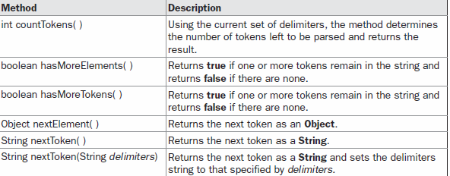
The Methods Defined by StringTokenizer

Slide 40
Example
public static void main(String args[ ]){
StringTokenizer st = new StringTokenizer("my name is khan", " ");
while (st.hasMoreTokens( ) ) {
System.out.println(st.nextToken());
}

Slide 41
Example
public static void main(String[] args) {
StringTokenizer st = new StringTokenizer("my,name,is,khan");
// printing next token
System.out.println("Next token is : " + st.nextToken(","));
}

Slide 42
BitSet
A BitSet class creates a special type of array that holds bit values. This array can increase in size as needed.
The BitSet constructors are shown here:
BitSet( )
BitSet(int size)

Slide 43
Vector

Slide 44
Stack

Slide 45
HashTable
Hashtable stores key/value pairs in a hash table.
It contains only unique elements.
Neither keys nor values can be null.

Slide 46
HashTable
It is declared like this:
class Hashtable<K, V>
Here, K specifies the type of keys, and V specifies the type of values.
The key is then hashed, and the resulting hash code is used as the index at which the value is stored within the table.

Slide 47
HashTable Methods
Object put(Object key, Object value) Inserts a key and a value into the hash table.
Object get(Object key) Returns the object that contains the value associated with key. If key is not in the hash table, a null object is returned.
Enumeration keys( ) Returns an enumeration of the keys contained in the hash table.
boolean containsKey(Object key) Returns true if some key equal to key exists within the hash table. Returns false if the key isn't found.
boolean containsValue(Object value) Returns true if some value equal to value exists within the hash table. Returns false if the value isn't found.

Slide 48
Exercise
Write a Java Program Which includes a class called searching with an integer array as member, which will be initialized by using random number generator object. Write a function to search an input element in that integer array using linear search.

Slide 49
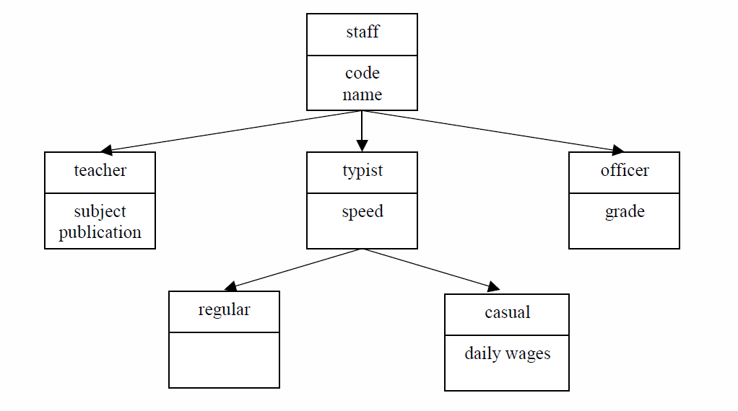
Exercise

